Slide 1
Green University of Bangladesh
Department of Computer Science & Engineering
Subject:Digital Logic Design Lab
Course Code:CSE204
My Project Presentation topic :Traffic Light Controller
Submitted To:
Name : Md. Atikuzzaman
Designation : Lecturer
Department : CSE
Green University of Bangladesh
Submitted by :
Name : Nazifa Alam Nowrin
ID : 193002103
Department :CSE

Slide 2
Outline:
Introduction
Components Required
Control lights indication
Block Diagram
Project Images
Project Code
Applications

Slide 3
Introduction:
The function of traffic light is to provide sophisticated control and coordination to ensure that traffic moves as smoothly and safely as possible.
This project uses a LED light as an indicator. A microcontroller for auto change signal after a specific time interval. The LEDs are automatically on and off by making the corresponding port pin of the microcontroller high

Slide 4
Components Required:
Arduino UNO Board
Red, Green, Yellow(amber) LED’s
Resistors
Breadboard
Power supply

Slide 5
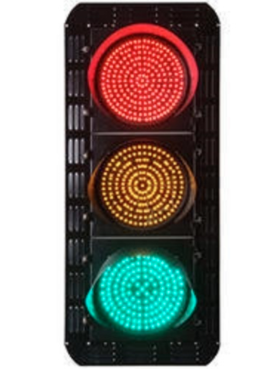
Control lights indication

Slide 6
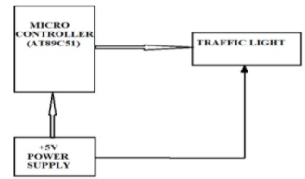
Block Diagram:

Slide 7
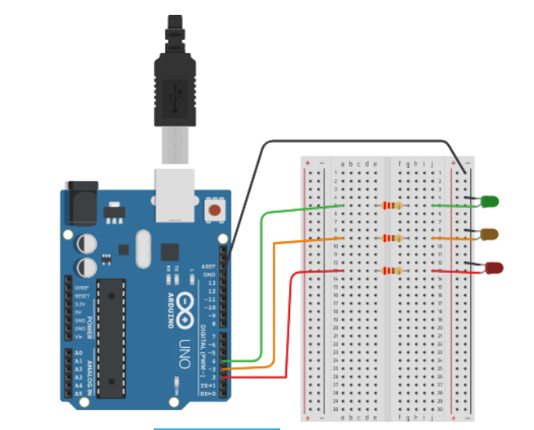
Project Images:

Slide 8
Project Code:
void setup()
{
pinMode(4, OUTPUT);//for green led
pinMode(3, OUTPUT);//for orange led
pinMode(2, OUTPUT);//for red led
}
void loop ()
{
digitalWrite(4, HIGH);//turn on green led delay (3000); //wait for 3 seconds digitalWrite(4, LOW);//turn off green led digitalWrite(3,HIGH);//turn on orange led delay(1000);//wait for 1 second digitalWrite(3, LOW);//turn off orange led digitalWrite(2, HIGH);//turn on red led delay(3000);//wait for 3 seconds digitalWrite(2,LOW);//turn off red led }

Slide 9
Applications:
1.timer
2. fire station or medical emergency entrance
3. at the entrance and exit of some car washes
4. at the landing stage of a ferry and abroad the ferry

Slide 10
Any Question?

Slide 11
Thank you

